Slide 1

Greenplum Database Initialization
Notes:
Intro: my name is, my role is, …

Slide 2
Agenda
Initializing the Greenplum System
Greenplum Array Configurations
Mirroring Options
Notes:
In this lab, you will prepare your system for installation and then install the Greenplum binaries. You will also verify the state of the system by running verification tests.

Slide 3
Greenplum Database System Initialization
To initialize the Greenplum Database:
Create a host list file with all segment host names
Create the system configuration file, in this example, gp_init_config
Set the correct locale for the database on the master server
Run gpinitsystem on the master host Example: gpinitsystem -c gp_init_config
Notes:
In a Greenplum DB, each database instance, the master and all segments must be initialized across all of the hosts in the system in such a way that they can all work together as a unified DBMS. Greenplum has its own version of initdb called gpinitsystem, which initializes the database on the master and on each segment instance. This differs slightly from its predecessor, PostgreSQL.
To initialize the Greenplum Database, you must:
Create a host list file that contains the name of the segment hosts involved in the array.
Create a configuration file that describes the system setup, including how many segments per host, data directory locations, if mirroring is enabled, and so on. If you are using multiple network interfaces and have multiple segment hostnames per host, it is important that the host file referenced in the configuration has ALL per-interface hostnames for a segment.
On the master server, define the locale you wish to use for the database. Some locale options cannot be changed after initialization or upgrade, so it is best to verify the setting before.
Execute the Greenplum Database initialization utility to create the database instance specified in the system configuration file.
After the Greenplum database system has been initialized, it is then ready for use. You can then create and manage databases as you would in a regular PostgreSQL DBMS.

Slide 4
Greenplum Database Configuration File
ARRAY_NAME="Greenplum"
MACHINE_LIST_FILE=/home/gpadmin/gpconfigs/hostfile_gpinitsystem
SEG_PREFIX=gpseg
PORT_BASE=50000
declare -a DATA_DIRECTORY=(/data1/primary /data1/primary /data1/primary /data2/primary /data2/primary /data2/primary)
MASTER_HOSTNAME=mdw
MASTER_DIRECTORY=/data/master
MASTER_PORT=5432
TRUSTED SHELL=ssh
CHECK_POINT_SEGMENT=8
ENCODING=UNICODE
#Option Entries for segment mirrors
MIRROR_PORT_BASE=50000
REPLICATION_PORT_BASE=41000
MIRROR_REPLICATION_PORT_BASE=51000
declare -a MIRROR_DATA_DIRECTORY=(/data1/mirror
/data1/mirror /data1/mirror /data2/mirror /data2/mirror /data2/mirror)
sdw1-1
sdw1-2
sdw1-3
sdw1-4
sdw2-1
sdw2-2
sdw2-3
sdw2-4
Notes:
The Greenplum Database Configuration file contains the required parameters necessary for initializing your Greenplum Database. The file defines the following parameters:
ARRAY_NAME – The unique name of your array
MACHINE_LIST – File name containing the list of segment hosts in the array
SEG_PREFIX – The prefix used for the data directories on the master and segment instances
PORT_BASE – The base port number for the primary segments – this value is incremented by 1 for each primary segment defined
DATA_DIRECTORY – The data directories for the primary segments
MASTER_HOSTNAME – The hostname of the master host
MASTER_PORT – The port number of the master instance
TRUSTED_SHELL – The type of shell gpinitsystem uses to execute commands on remote hosts
CHECK_POINT_SEGMENT – The maximum distance between automatic write ahead logs(WAL) checkpoints
ENCODING – The character encoding to use
DATABASE_NAME – This optional parameter specifies the database to create on initialization
MIRROR_PORT_BASE - The base port number for the mirror segments – this value is incremented by 1 for each mirror segment defined
REPLICATION_PORT_BASE - The base number by which the port numbers for the primary file replication process are calculated - this value is incremented by 1 for each primary segment defined
MIRROR_REPLICATION_PORT_BASE - The base number by which the port numbers for the mirror file replication process are calculated - this value is incremented by 1 for each mirror segment defined
MIRROR_DATA_DIRECTORY – The data directories for the mirror segments
Pick the values here very carefully
Example: net.ipv4.ip.local_port_range lists 1025 65525 (Ivan is going to change this in the GPDB docs so that is is more reasonable like 1025 32000)
We do this because when you init the system, it will randomly attempt to pick a port in the range specified, but if it happens to pick the pre-selected ports that GPDB needs (like 50000, 41000, 51000), then you’ll get an init error and after a lot of debugging you will find that it didn’t work because of a port conflict
So, in the previous unit where we listed some of these setup variables, we want to tie it back to this configuration file to make sure there are no conflicts.

Slide 5
Agenda
Initializing the Greenplum System
Greenplum Array Configurations
Mirroring Options
Notes:
In this lab, you will prepare your system for installation and then install the Greenplum binaries. You will also verify the state of the system by running verification tests.

Slide 6
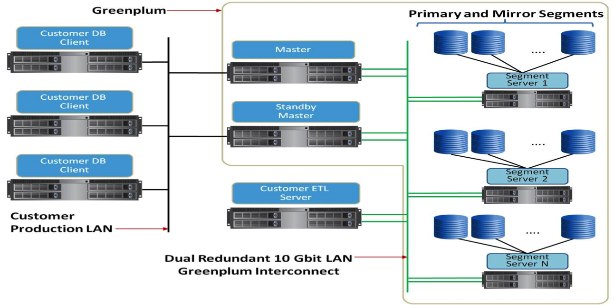
Production Greenplum Cluster
Notes:
In this configuration, there is one master, one standby master, and two or more segments per host, with one primary segment per CPU core. The network configuration shows that there are multiple network interfaces per segment. Each interface is connected to the interconnect.
An ETL server is connected directly to the interconnect as well to improve performance for data loads.
This represents one type of array configuration that is commonly used in production environments.

Slide 7


Greenplum Segment Host Allocation
Primary Segments are:
Can be either Master or segment instances
Mirror segments are:
A replica of a given primary segment
Used for data redundancy
Mirroring can be enabled:
At array initialization time
On an active Greenplum Database system:
Primary segment
Mirror segment
Segment host
Notes:
Instruction Note: This slide should be kept high level to introduce the concept of Primaries and Mirrors. More detail follows in the rest of the UNIT. DO NOT dive into too much detail on this slide
The purpose of this slide is to introduce the terms: Primary and mirror, and to lay the groundwork for talking about the gp_init sequence and what happens if there is a failure. All of which are covered in the remaining slides.

Slide 8
Greenplum DB init sequence
To see the state of a Greenplum system (after it has been initialized) you can run a simple SELECT command
SELECT * from gp_segment_configuration;
This shows a lot of information, but the mode column is valuable:
S means it is in sync – no need to do anything out of the ordinary
C mean change tracking mode – this means that the system has noticed that there is a Primary without a Mirror
R means resync mode – means that the system is attempting to resync the mirror by playing back the change log
Notes:
Instruction Note: This slide goes into some detail, but it is really intended so that students know what is going on if the Mirror fails, or if the Primary fails. These are two different scenarios
once you are in a state where you have a primary without a mirror you go into change tracking state (gp_segment_configuration MODE colum = C).
When you have a primary segment and the mirror is down, the primary goes into change mode which means its recording segments. When, if, the mirror comes back online, then the system goes into resync mode (gp_segment_configuration MODE colum = R).
resync - tries to replay change track – this causes the change tracking logs to be replayed to the mirror so only the incremental changes are updated on the other side.
by default it is an incremental recovery
If this doesn’t work then it performs a full recovery

Slide 9
Creating Mirrors for High Availability and Redundancy
Master mirroring:
Lets you create a warm standby master
Starts the synchronization process between hosts
Segment mirroring:
Creates a mirror segment for a primary segment
Requires enough nodes to spread mirroring
Can be configured on same array of hosts
Sync process
Master host
Primary segment
Mirror segment
Standby master host
Segment host
Notes:
You can enable mirroring in the Greenplum database during the database initialization phase at setup time, or to an existing system that was configured without mirroring.
There are two types of mirrors that can be configured:
Master mirroring – When mirroring the master, a warm standby master is created. Once configured, the synchronization or replication process between the master and the standby master is executed. This synchronization process, gpsyncagent, is executed from the standby master and ensures that the data between both systems are synchronized. Should the master host become unavailable:
The replication process is stopped.
The replication logs are used to reconstruct the state of the master at the time of the failure.
The standby master can be activated to pick up from the last set of successful transactions completed by the master.
Segment mirroring – A mirror segment is normally configured on a different host than its primary counterpart. It can be configured on systems outside of the array (but this is not recommended). Changes to the primary segment are copied over to the mirror segment using a file block replication process. Until a failure occurs, there is no live segment instance running on the mirror host, only the replication process. Should the primary segment become unavailable:
The file replication process is stopped.
The mirror is automatically onlined as a primary segment.
Notes for Instructor from Scott Kahler
Mirror segments can be deployed:
On the same hosts as your primary segments (Not recommended) <- make it clear we are talking about a failure pair not existing on the same host, so not possibly thinking this means separate servers for primaries and mirrors
On a different set of host that your primary segments ( Spread Mirroring) <- this isn't necessarily spread mirroring, would leave that out for a slide about what spread mirroring is vs mirror pairs
Mirroring in Greenplum - Spread Mirror Distribution
Should talk about mirror pairs first where A mirrors on B.. B mirrors are on C.. C mirrors on D.. etc. Not best idea but needed in some situations where you can't go spread
Mirroring in Greenplum - Rebalancing Segments
Follow up slide on gpstate usage, so you know when balancing is done

Slide 10
Warm Standby Master
A warm standby master is:
A replica of the Greenplum master instance (system catalogs)
Used to remove single point of failure
Kept up to date by the WALsender (Primary Master) and WALreceiver (Standby Master) replication processes
System Catalogs and Transaction Logs are replicated.
Sync process
Primary Master host
(WALsender)
Standby Master host
(WALreceiver)
WAL = Write Ahead Log
Notes:
A backup or mirror master host serves as a warm standby in the event of the primary master host becoming inoperative. The warm standby master is kept up to date by a transaction log replication process, which runs on the backup master host and keeps the data between the primary and backup master hosts synchronized. The master does not have user data, only system catalog tables. By creating the warm standby master, you ensure that the master is no longer a single point of failure.
You can enable a standby master on a segment host or on a new host. If you are creating the standby master on a host outside of the existing array, verify that the pg_hba.conf file of the current master and segments allow connections from the new standby master host. If you add the standby at initialization time, this process is automatically completed for you.

Slide 11
Adding a Standby Master
Add a standby master to an existing Greenplum system:
Add a standby master during initialization:
Verify Greenplum binaries were installed
Source /usr/local/greenplum-db/greenplum_path.sh
Exchange keys
Create data directories
Initialize the database with the following: gpinitstandby –s standby_hostname
Verify Greenplum binaries were installed
Source /usr/local/greenplum-db/greenplum_path.sh
Create data directories
Initialize Greenplum and specify the warm standby master with the following: gpinitsystem –c gp_init_config -s standby_hostname
Notes:
To add a standby master to an existing Greenplum database system:
Verify Greenplum has already been installed and configured on the standby master and that host keys have already been exchanged. This includes ensuring that the superuser account has been created, the binaries for Greenplum installed, the variables configured, keys exchanged, and data directories created on the standby master.
Run gpinitstandby on the active primary master. Include the -s option followed by the host name of the standby master.
At initialization time, include the –s option followed by the hostname of the standby master when executing the gpinitsystem command.

Slide 12
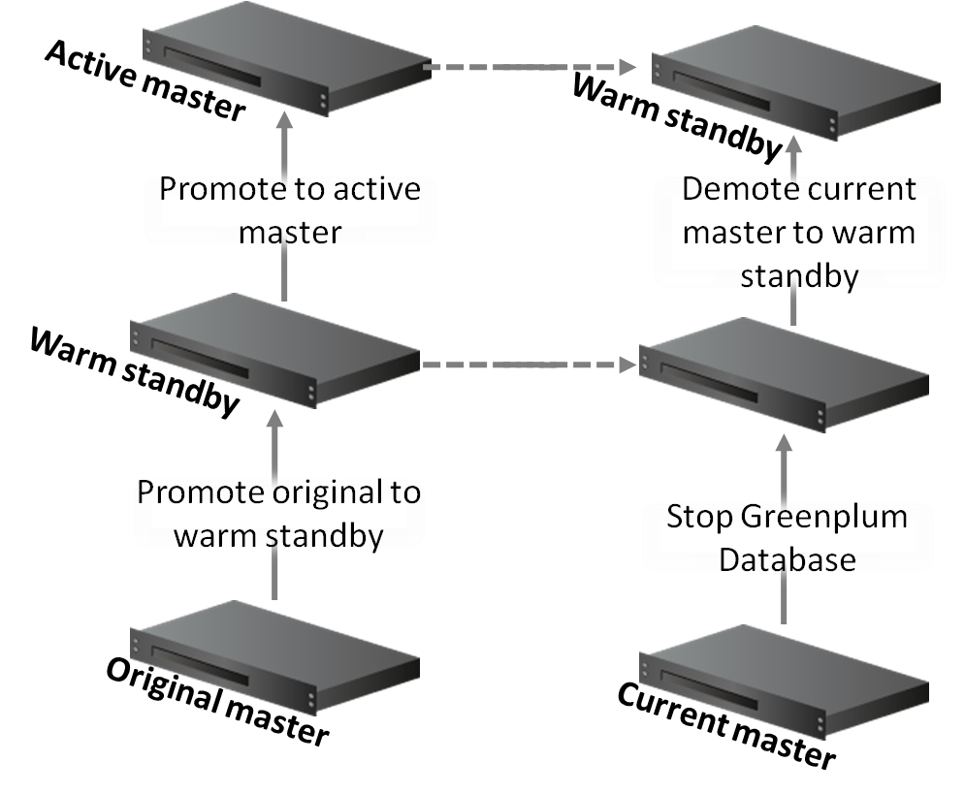
Primary Master Failure and Restoration
Notes:
Instructor NOTE:
This is an overview slide and should not be explained here. Note to the instructor to explain in the the next 3 slides. Make sure you go through the next three slides. DO NOT spend much time on this slide.
Slide 12 - is confusing. I'm guessing it reads bottom up. If that is the case, "original master" and "current master" are weird labels. Where does the failure happen? I think this slide is switching from the "acting stand-by" back to "fixed failed master" If this is the case, the slide header is wrong. =) I would switch it to go from top to bottom. "Original master" is "failed master."
The warm standby master offers a measure of protection for your database by assuming the role of primary should the original primary master fail. The synchronization process, WALsender and WALreceiver, allows the standby to be engaged with little to no loss of data by keeping the transaction log data between the primary and standby masters synchronized. In-flight transactions may need to be restarted.
When the primary master fails, the warm standby is manually promoted as the active master. Once the primary master becomes available, it can be promoted to its original role, demoting the warm master from the active mode to its original warm standby role.

Slide 13
Promoting a Warm Standby to an Active Primary Master
Promote a standby master to primary:
On the standby master, run: gpactivatestandby -d $MASTER_DATA_DIRECTORY
Optionally, configure a new standby that has already been configured: gpactivatestandby -d $MASTER_DATA_DIRECTORY –c new_standby_hostname
Verify the active master is Active and the standby is Passive, if configured: gpstate -f
Active master
Promote warm standby to active
Warm standby master
Notes:
To promote the warm standby you configured to be the master:
Run the gpactivatestandby -d $MASTER_DATA_DIRECTORY command on the warm standby. This promotes the warm standby to now be the active primary master.
Optionally, define a new warm standby with the gpactivatestandby command. The -c option allows you to specify the hostname to the new warm standby.
Once you have promoted the warm standby to be an active primary master, verify the state of the servers with the gpstate -f command.

Slide 14
Promoting the Original Master to the Active Master
Active master
Promote the original failed master back to a master:
Fix problems on the original standby and verify the Greenplum Database processes have not started.
Initialize the original master as a standby master: gpinitstandby –s original_master_hostname
Stop the Greenplum Database on the current master: gpstop –m
Promote to active master
Warm standby
Promote original to warm standby
Original master
Notes:
If the original master has been restored, you can promote it back to an active master with the following steps:
Ensure that the Greenplum Database is not running on the original master. The in stance should already be running on the server currently acting as the primary master.
Initialize the original master so that it is now a warm standby. This is done with the gpinitstandby command with the -s option that allows you to specify the name of the original master.
Stop the Greenplum database on the current master using the gpstop -m command. The -m option stops only the master.

Slide 15
Promoting the Original Master to the Active Master (Cont)
Warm standby
Promote the original failed master back to a master:
Promote the original master from a standby to the master: gpactivatestandby -d $MASTER_DATA_DIRECTORY
Reinitialize the original standby master to be the standby master again: gpinitstandby -s original_standby_master_hostname
Check the state of the master and standby master: gpstate -f
Demote current master to warm standby
Stop Greenplum Database
Current master
Notes:
Promote the original master, which is now acting as a warm standby, to be the active primary. Use the gpactivatestandby command to promote the original master.
Initialize the master that was acting as a primary master to now act as a standby master. Use the gpinitstandby command to demote this server.
Check the state of the master and current standby servers using the gpstate -f command. The original master should now show as Active and the standby status should now be Passive.

Slide 16
Agenda
Initializing the Greenplum System
Greenplum Array Configurations
Mirroring Options
Notes:
In this lab, you will prepare your system for installation and then install the Greenplum binaries. You will also verify the state of the system by running verification tests.

Slide 17
Mirror Segments
Mirror segments are:
A replica of a given primary segment
Used for data redundancy
Mirroring can be enabled:
At array initialization time
(set parameters in gp_init_config file)
On an active Greenplum Database system:
gpaddmirrors command
Mirror segments can be deployed:
On the same hosts as your primary segments (Not recommeneded)
On a different set of host that your primary segments (Spread Mirroring)
Primary segment
Mirror segment
Segment host
Notes:
Mirrored segments replicate a primary segment counterpart providing redundancy and fault tolerance support for your data. Database queries can fail over to a mirror segment should the primary segment be unavailable.
Mirroring can be enabled:
At array initialization by setting parameters in the gp_init_config system configuration file you defined earlier.
On an active Greenplum Database using the same hosts as the primary segments by:
Creating data storage for the mirror on a different file system than the primary segment is using
Exchanging SSH keys as segment hosts must be able to SSH and SCP to each other without a password
Running the gpaddmirrors utility with the -p option, followed by the number to add to your primary port segment number to determine the port number for the mirror
Mirror Segments (continued)
On an active Greenplum Database using different hosts than the primary segments by:
Verifying all segments have Greenplum installed
Allocating data storage for mirror segments on all segment hosts
Exchanging SSH keys
Creating a configuration file with the host names, ports, and data directories where you want your mirrors created. You can use gpaddmirrors -o filename to create a sample file that you can edit with your true parameters.
Running the gpaddmirrors -i filename, where filename is the name of the file that contains the mirror configuration.
Note: If using a multi-NIC configuration (multiple host names per segment host), DO NOT enable mirrors at initialization time. Do so after you have initialized and edited the system catalog. You can then run gpaddmirrors.

Slide 18
Mirroring in Greenplum – Spread Mirror Distribution
P1
P2
P3
M6
M8
M10
Segment Host 1
P4
P5
P6
M1
M9
M11
Segment Host 2
4 Segment Hosts
3 Primary Segment Instances
P7
P8
P9
M2
M4
M12
Segment Host 3
P10
P11
P12
M3
M5
M7
Segment Host 4
Spreads the mirror segments across the available hosts
Mirror spreading will place each mirror on a different host within the Greenplum Database array
Spreading is only allowed if there is a sufficient number of hosts in the array
Number of hosts is greater than the number of segment instances
Notes:
In this example, we focus on the spread mirror distribution for 4 segment hosts with 3 primary segments per host.
In spread mirror distribution, mirror segments are spread across the segment servers so that no single server contains more than one mirror for another segment server. This spreads the mirror segments across the available hosts, balancing the mirrors and reducing the chances that the failure of a single segment will impact the database.
Mirror spreading will place each mirror on a different host within the Greenplum database array. Spreading is only allowed if there is a sufficient number of hosts in the array. To meet this requirement, the number of hosts must be greater than the number of segment instances.
Note that cluster expansions and upgrades need to be carefully planned out to insure proper spreading of new mirrors across all the servers in the cluster.

Slide 19
Fault Detection and Recovery
Fault detection:
Is handled by ftsprobe
Marks a segment as down when a connection fails or a response timeout is exceeded.
Allows subsequent connection requests to switch to the mirror and succeed
Requires Greenplum administrators to manually recover a segment marked invalid with gprecoverseg
May also require that the Greenplum administrator has to manually rebalance the database cluster with a gprecoverseg -r
Requires vigilance from Greenplum administrators
Notes:
Fault detection is handled by ftsprobe , a Greenplum Database server subprocess. This fault detection process monitors the Greenplum array, scanning all segments and database processes at configurable intervals.
Whenever the fault detection process cannot connect to a segment, it marks that segment instance as down in the Greenplum Database system catalog. Once a segment is down, it will remain out of operation until an administrator initiates the recovery process to bring that segment back online.
When mirroring is enabled in a Greenplum Database system, the system will automatically failover to the mirror copy whenever a primary copy becomes unavailable. A Greenplum Database system can remain operational if a segment instance or host goes down as long as all portions of data are available on the remaining active segments.

Slide 20

Mirroring in Greenplum – Failed Primary Segment Example
P1
P2
P3
M6
M8
M10
Segment Host 1
P4
P5
P6
M1
M9
M11
Segment Host 2
P7
P8
P9
M2
M4
M12
Segment Host 3
P10
P11
P12
M3
M5
M7
Segment Host 4
Primary Segments
Mirror Segments
Primary Segment Failure:
The ftsprobe process on the master detects the segment down and marks it invalid.
Notes:
Over the next few slides, we will examine how the failure of a segment is detected and handled by Greenplum Database.
Primary segment P5 on segment host 2 is marked down and invalid. The ftsprobe process initiates a failover to mirror segment M5 mirror on segment host 4.

Slide 21
Mirroring in Greenplum – Failed Primary Segment Example
P1
P2
P3
M6
M8
M10
Segment Host 1
P4
P5
P6
M1
M9
M11
Segment Host 2
P7
P8
P9
M2
M4
M12
Segment Host 3
P10
P11
P12
M3
P5
M7
Segment Host 4
Primary Segments
Mirror Segments
Primary Segment Failure:
The mirror segment is validated to ensure that it was synchronized with its primary segment. Mirror segment becomes the primary.
Notes:
Mirror segment M5, on segment host 4, is validated to be in sync with the corresponding primary that became unavailable. The M5 mirror is now promoted to become the primary segment P5.

Slide 22
Mirroring in Greenplum – Failed Primary Segment Example
P1
P2
P3
M6
M8
M10
Segment Host 1
P4
M5
P6
M1
M9
M11
Segment Host 2
P7
P8
P9
M2
M4
M12
Segment Host 3
P10
P11
P12
M3
P5
M7
Segment Host 4
Primary Segments
Mirror Segments
Primary Segment Failure:
Once it has been determined why the original primary P5 went down and is repaired, you can then bring that segment back online to become the mirror segment to protect the new primary P5.
Notes:
Once repaired and made available, the original P5 primary segment can be brought back online. When brought back online it will become the mirror M5, protecting the new P5 primary segment.

Slide 23

Mirroring in Greenplum – Failed Primary Segment Example
P1
P2
P3
M6
M8
M10
Segment Host 1
P4
M5
P6
M1
M9
M11
Segment Host 2
P7
P8
P9
M2
M4
M12
Segment Host 3
P10
P11
P12
M3
P5
M7
Segment Host 4
Primary Segments
Mirror Segments
Primary Segment Failure:
Run the gprecoverseg command to bring back up the segment that went down. The old primary P5 becomes the M5 mirror.
Notes:
Use the gprecoverseg command to restore the original roles of the primary and mirror segments. The database stores information on the roles as originally configured as well as their current status in the gp_segment_configuration table. By issuing the gprecoverseg command, Greenplum:
Brings recovered segments back online.
Restores all segments to their original roles
Verifies that all segments are valid
Synchronizes the changed database files with the active segment

Slide 24
Mirroring in Greenplum – Re-balancing Segments
P1
P2
P3
M6
M8
M10
Segment Host 1
P4
M5
P6
M1
M9
M11
Segment Host 2
P7
P8
P9
M2
M4
M12
Segment Host 3
P10
P11
P12
M3
P5
M7
Segment Host 4
Primary Segments
Mirror Segments
The database cluster is in an un-balanced condition
Segment Host 2: Two Primaries, 4 Mirrors
Segment Host 4: 4 Primaries, 2 Mirrors
Notes:
Before rebalancing the segments, segment host 2 and segment host 4 are in an un-balanced condition. Segment host 2 has 2 primaries and 4 mirrors, and segment host 4 has 4 primaries and 2 mirrors. From a processing of queries perspective, segment host 4 will be processing more and could cause query performance issues. To re-balance the database cluster, run gprecoverseg -r command to accomplish this.

Slide 25
Mirroring in Greenplum – Re-balancing Segments
P1
P2
P3
M6
M8
M10
Segment Host 1
P4
P5
P6
M1
M9
M11
Segment Host 2
P7
P8
P9
M2
M4
M12
Segment Host 3
P10
P11
P12
M3
M5
M7
Segment Host 4
Primary Segments
Mirror Segments
Run the following command to re-balance the cluster
gprecoverseg -r
The database cluster would then be back in a balanced condition
Segment Host 2: 3 Primaries, 3 Mirrors
Segment Host 4: 3 Primaries, 3 Mirrors
Notes:
Once gprecoverseg has successfully executed, the original roles are assigned to the segments.

Slide 26
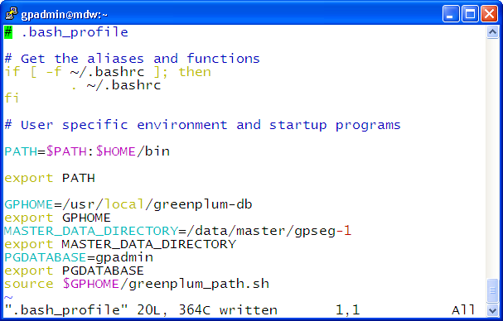
Setting Greenplum Environment Variables
GPHOME points to the base Greenplum directory (executables and libraries)
PGDATABASE sets up your default database to connect to
MASTER_DATA_DIRECTORY is the location of the data directory on the master server
Always source the greenplum_path.sh file
(sets up paths to executables and libraries)
Notes:
Once you have initialized the Greenplum Database, you must configure the Greenplum environment by setting up or accessing several variables that will be used when you access or administer the database.
To configure the environment, perform the following on the master and standby servers:
Set the value of the MASTER_DATA_DIRECTORY variable to the location of the data directory on the master server. This variable is used when starting, stopping, or otherwise accessing the Greenplum Database.
Source the contents of the /usr/local/greenplum-db/greenplum_path.sh file. This will set the value of other environment variables used by Greenplum.
Add these settings to the .bash_profile or .bashrc file for the gpadmin user. By adding it to the .bash_profile file, the variables will be read once when you log into the system as the gpadmin user. If you add it to the .bashrc file, it will be read for each separate shell session you initiate as the gpadmin user.
Optionally, you can configure several other variables that will override the behavior of the Greenplum client, psql. These variables will be explained in greater detail later in the course.

Slide 27
Wrap Up
During this lesson, the following topics were covered
Initializing the database
Array configurations
Mirroring options
Notes:
In this lab, you will continue configuring your Greenplum database environment by initializing the Greenplum Database system. You will also configure mirrors for the primary segments you have configured as part of the lab.

